Slide 1
The Effect of Fastball Velocity on Pitcher AAV
CJ Whaley

Slide 2
Introduction
Research Question: How important is fastball velocity in determining AAV for pitchers?
  Further Research: Does the impact of fastball velocity differ between left and right-handed pitchers? Starting pitchers and Relief pitchers?
Why do we care?
  Velocity has increased dramatically over last 25 years
    2008: 91.9 mph 2023: 94.2 mph
  Throwing injuries have increased alongside

Slide 3
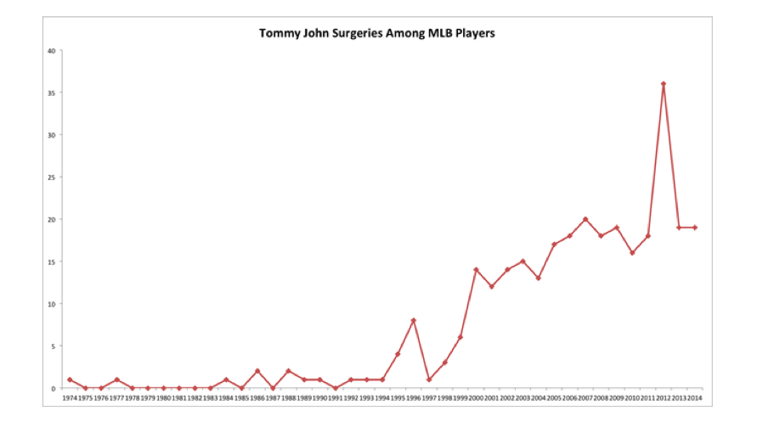
https://www.samford.edu/sports-analytics/fans/2018/The-Tommy-John-Surgery-Explosion-in-the-MLB#:~:text=Growing%20in%20Number,%E2%80%9D%20(Stark%2C%202014).

Slide 4
Data
Data Source: MLB Free Agent Data, 2022-2024
Estimating Sample:
  Removed all position players
    Including two-way players, like Shohei Ohtani
  Removed any pitchers with missing velocity data
  Removed any pitchers who failed to sign a deal
  171 observations remain after trimming

Slide 5
Model
log(AAV) = β₀ + β₁FB_Velo_avg*lefty*SP + β₂Age + β₃careerWAR + β₄FIP + β₅large_market + ε
log(AAV) is the natural log of a player’s Average Annual Value of their contract
FB_Velo_avg is a player’s average fastball velocity in mph
lefty is a dummy variable where lefty=1 for players who throw left-handed
SP is a dummy variable where SP=1 for players who are Starting Pitchers
Age is the age of the player in years
careerWAR is a player’s total WAR accumulated in their career
FIP is a player’s Fielding Independent Pitching value
large market is a dummy variable where large_market=1 for players who signed with a large market team (NYY, NYM, LAA, LAD, CHC, CHW, BOS, PHI)

Slide 6
Results
 | (1)
VARIABLES | logAAV
FB_Velo_avg | 0.140**
 | (0.063)
1.lefty | -4.129
 | (9.124)
1.lefty#c.FB_Velo_avg | 0.044
 | (0.097)
1.SP | -1.127
 | (9.267)
1.SP#c.FB_Velo_avg | 0.022
 | (0.098)
1.lefty#1.SP | 1.139
 | (12.448)
1.lefty#1.SP#c.FB_Velo_avg | -0.009
 | (0.133)
Age | -0.001
 | (0.028)
careerWAR | 0.020***
 | (0.005)
FIP | -0.261***
 | (0.092)
large_market | 0.042
 | (0.129)
Constant | 2.565
 | (6.390)
Observations | 171
R-squared | 0.487
FB_Velo_avg, careerWAR, and FIP are the only statistically significant results
Market size was both statistically and economically insignificant
FIP and WAR performed as expected

Slide 7
Conclusions
A 1 mph increase in average fastball velocity is associated with a 14% increase in AAV, for right-handed relief pitchers
Left-handed relievers may gain an additional 4.4% in AAV per 1 mph
Starting pitchers may gain an additional 2.2% in AAV per 1 mph
Left-handed starters may actually see slightly less than a 14% increase in AAV per 1 mph

Slide 8
Limitations
Additional data needed, 171 observations is a small sample
Unobservable factors like injury history, command, pitch movement, or a unique delivery
Additional years of data could be used to measure velocity trends and the relationship between velocity and AAV

